Slide 1

TEAM MINIONS
Prediction of Rating by User Review
Notes:
hello!
I’m gonna present about our proejct which is predicting the rating by user review.

Slide 2





INDEX
INDEX
INDEX
INDEX
INDEX
01
02
03
04
INTRODUCTION
DATA DESCRIPTION
ABOUT PROJECT
RESULT
Introduction of short team, introduction of project
A Simple Description of our project’s data
Explanation of our project in detail.
Description of our result and present final demonstration.

Slide 3
01. INTRODUCTION

Slide 4

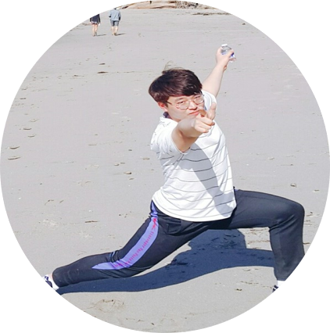

TEAM MEMBER
Briefly introduction of team Minions
DOKYEONG, KWON
TAESEUNG, LEE
Implementation of
Text multiple classification with CNN.
Implementation of
Text classification with RNN. And Connecting the prediction model with web server.
SEUNGWOO, PARK
PRESENTER
Implementation of
text pre-processing and web front-end.

Slide 5


"I feel so LUCKY to have found this used (phone to us & not used hard at all), phone on line from someone who upgraded and sold this one. My Son liked his old one that finally fell apart after 2.5+ years and didn't want an upgrade!! Thank you Seller, we really appreciate it & your honesty re: said used phone.I recommend this seller very highly & would but from them again!!"
"Very pleased"
"I originally was using the Samsung S2 Galaxy for Sprint and wanted to return back to the Samsung EPIC 4G for Sprint because I really missed the keyboard, I really liked the smaller compact size of the phone, and I still needed some of the basic functions of a smart phone (i.e. checking e-mail, getting directions, text messaging) Because the phone is not as powerful as the newer cell phones out there, just be aware that the more applications you install the slower the phone runs and will most likely freeze up from time to time. But the camera works great, the video is great as well, and even the web browsing is decent and gives me what I need. I also notice that battery life lasts a little bit longer and charging the phone is much quicker than my Galaxy S2."
"This is a great product it came after two days of ordering it. There was only one little blemish on the side,but who cares as long as the phone is fullly functional.i recommend this product to anyone reading this."
VS

Slide 6


What ?
Based on product reviews,
We convert the review to ratings.

Slide 7
02. DATA DESCRIPTION

Slide 8
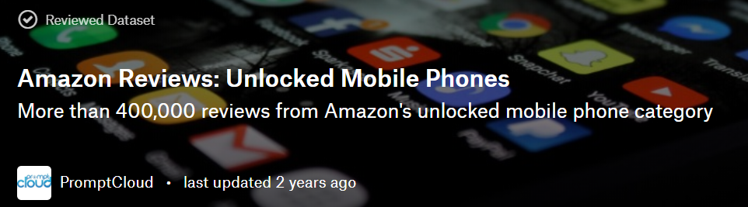
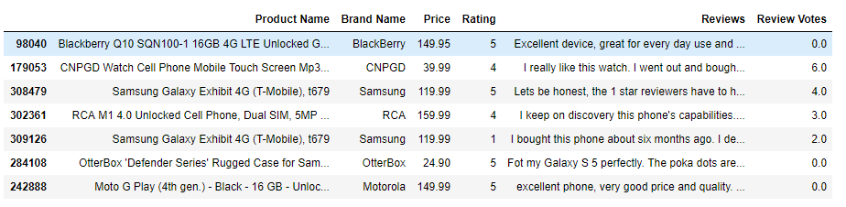
Data Set
https://www.kaggle.com/PromptCloudHQ/amazon-reviews-unlocked-mobile-phones/kernels

Slide 9
03. ABOUT PROJECT

Slide 10






Software Architecture
[-1,0,1,..,1]
[-1,0,1,..,1]
[-2,3,1,..,1]
Training
input
get
trained model
CNN/RNN
Optimized model
[-1,0,1,..,1]
Predicting
input
output

Slide 11
RNN
Recurrent Neural Network

Slide 12

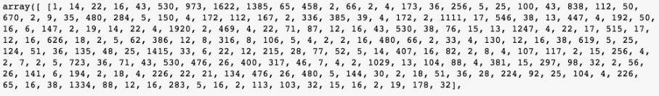
Training with RNN
STEP 1
Data Preprocessing
In this step, we preprocessing the word and, convert the word of review to word vector.

Slide 13
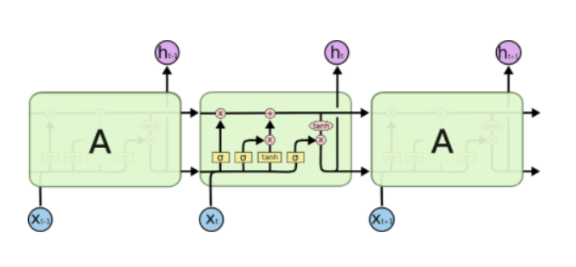

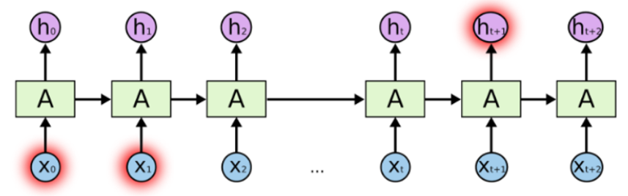
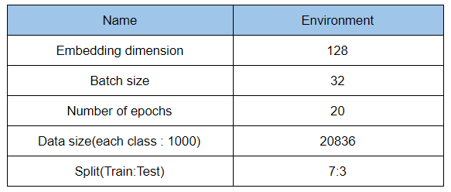
Training with RNN
Model
STEP 2
Long short-term memory
Modeling and Training
In this step, we made a model using LSTM algorithm. We implemented using Keras.
Environment

Slide 14
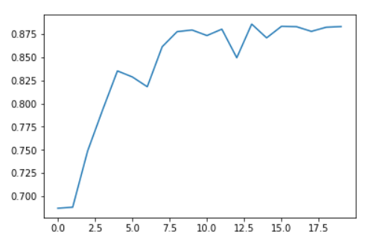
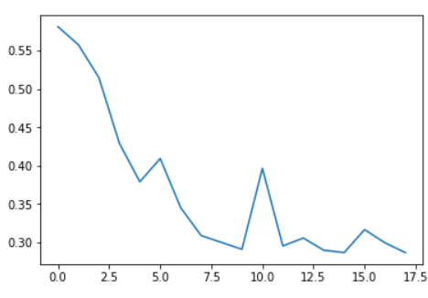

Training with RNN
Result
Accuracy
Loss

Slide 15
CNN
Convolutional Neural Network

Slide 16
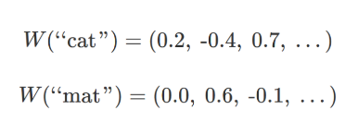
Training with CNN
STEP 1
OutPut of our review data
Make Vocabulary
In this step, we preprocessing the word and, convert the word of review to word vector.
After that, we make a vocabulary that suitable for our data.
(Just example)

Slide 17
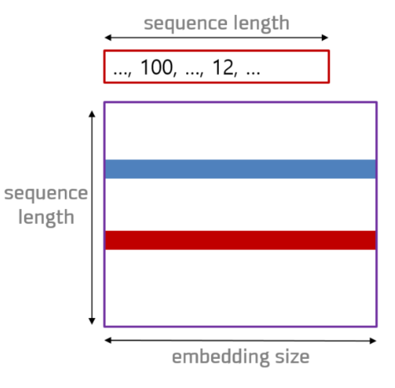

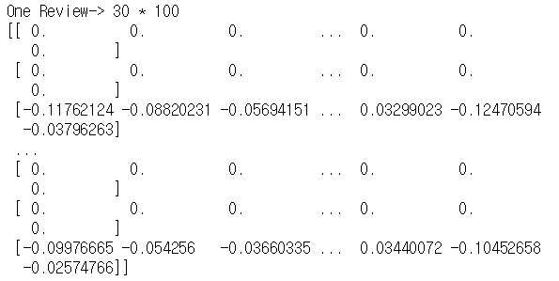
Training with CNN
STEP 2
Word Embedding
In this step, we matching the review with our word vector.

Slide 18
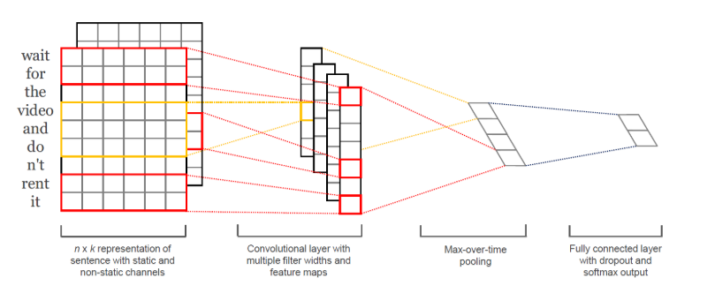
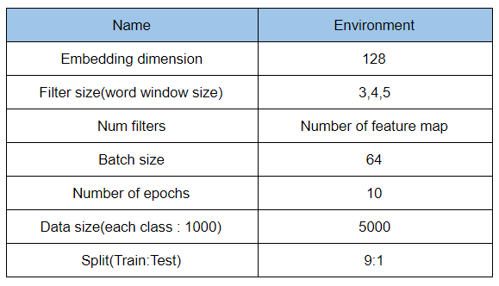
Training with CNN
Model
STEP 3
Modeling and Train
with CNN
In this step, firstly we made the model by using tensorflow. And after that, we trained our own review data.
Environment

Slide 19
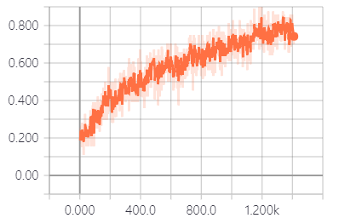
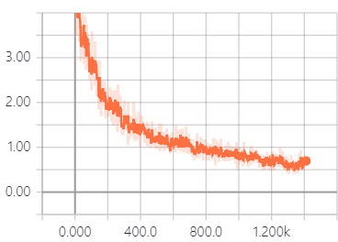
Training with CNN
Result
Accuracy
Loss

Slide 20
Let’s show DEMO

